Slide 1


Week 7: Advanced resonance
Ryan Ka Yau Lai
University of California, Santa Barbara

Slide 2


While we’re waiting …
Open SBC007 on Rezonator
Preferably a previously saved version
Choose left-justified grid view
Choose rez mode
Note today’s codeword and question on the board
Sit with your group members
Shameless plug: You can still enroll in LING 194 Visualising language in conversational interactions, which I teach in summer!
Apply for a scholarship here: https://ucsb.my.site.com/success/s/apply-for-summer-scholarship

Slide 3

Question for today
For one of the questions you’ve done in class today, point out the frame and focal resonances, and explain what function the focal resonance is performing in each line.

Slide 4
Things to look out for (Show 3)
Self-initiated vs other-initiated repair
Is there an explicit word/phrase that initiates the repair? Or is it implicit (e.g. just by cutting yourself off)?
Is the trouble caused by overlap or inaudible sounds?
Is the trouble caused by a mistake in what was spoken or not?
In the repair (completion) does the speaker start directly from the trouble source, or add a little bit of context before?
Grammatical, prosodic (e.g. cutting oneself off) & pragmatic cues for identifying trouble sources and repair initiations
Does the repair take place after a first pair part, after a second pair part, or neither? Does it take the form of insert or post expansion?

Slide 5
In this class, you will …
Practise
Practise annotating resonance in SBC007 and justifying your response
Navigate
Navigate between groups of resonances in Rezonator using the clique stackings
Understand
Understand the idea of ellipsis and annotate it in Rezonator
Deepen
Deepen your understanding of frame and focal resonance, and how we analyse these concepts

Slide 6
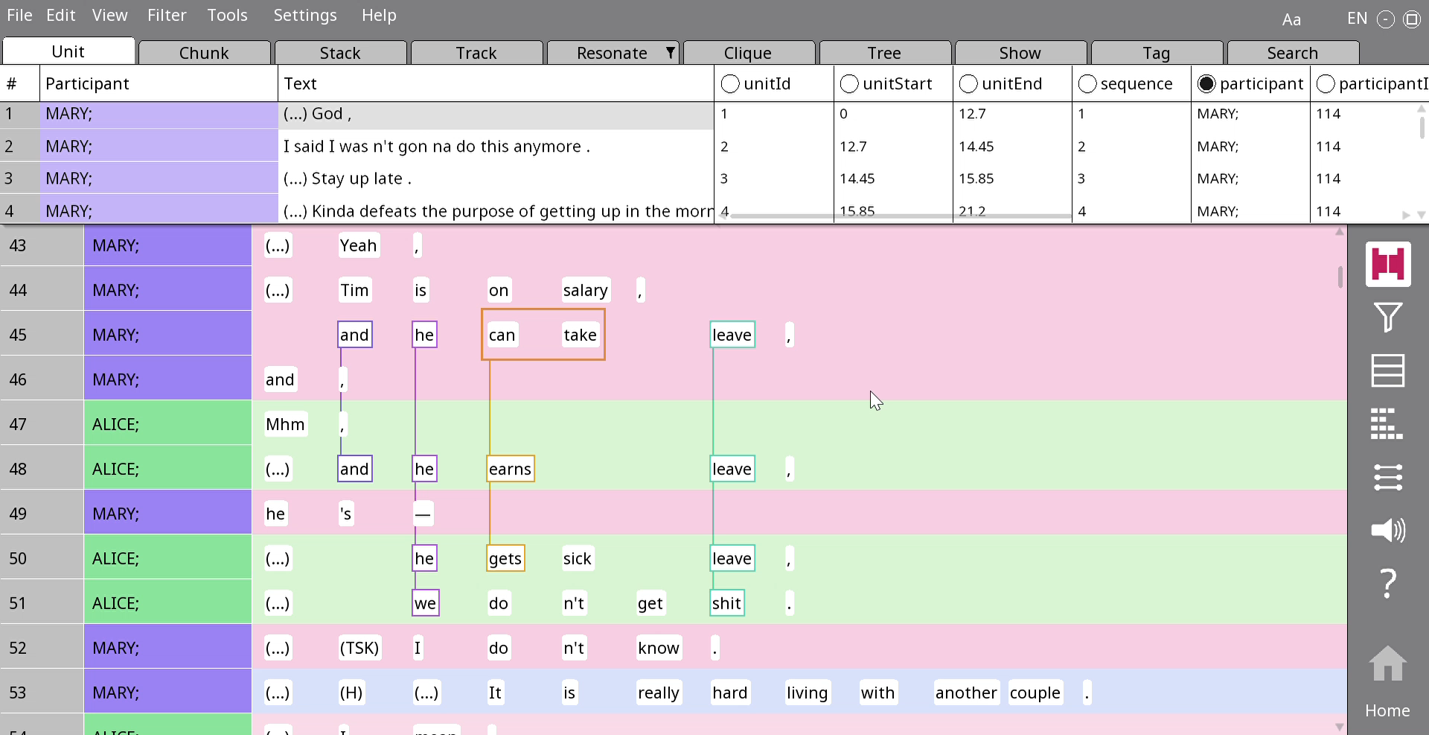
Adding a rez with multiple tokens
Just drag-and-drop
Note: This is not the same as sidelinks!!

Slide 7
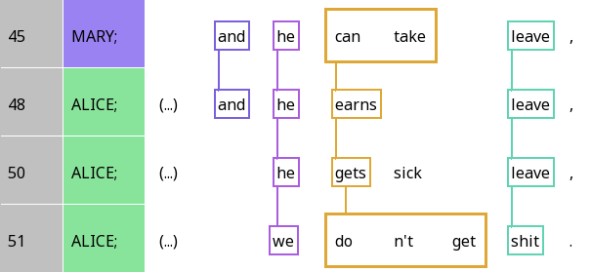
Frame resonance and focal resonance
Question: Which of the resonances between the third and fourth lines are frame resonances? Which are focal resonances? How does your answer differ from the relationships between the first three lines?

Slide 8
Frame resonance and focal resonance
Frame resonance
Focal resonance
Question: Which of the resonances between the third and fourth lines are frame resonances? Which are focal resonances? How does your answer differ from the relationships between the first three lines?

Slide 9
Diagraph
 | A | B | C | D | E
Mary | and | he | can take |  | leave
Alice | and | he | earns |  | leave
Alice |  | he | gets | sick | leave
Alice |  | we | don’t get |  | shit

Slide 10
Analysing analogies in focal resonance
 | B | C | E | C – interpretation
Mary | he | can take | leave | can – Possibility
Alice | he | earns | leave | -s – Habit
Alice | he | gets | leave | -s – Habit
Alice | we | don’t get | shit | don’t - Impossibility

Slide 11
Analysing analogies in focal resonance
 | B | C | E | E – interpretation
Mary | he | can take | leave | specific thing
Alice | he | earns | leave | specific thing
Alice | he | gets | leave | specific thing
Alice | we | don’t get | shit | anything

Slide 12

Your turn! (1)
Draw resonances in lines 1-12
Find examples of frame and focal resonance
Compare with your group members
Explain to your group members what kind of meaning is being created by the use of focal resonance

Slide 13
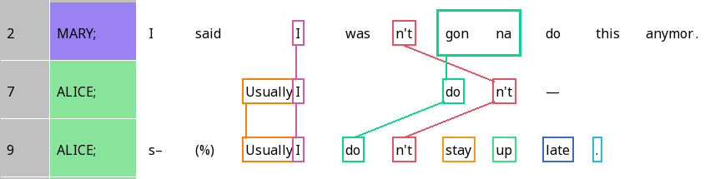
False starts in self-initiated repair
Self-resonance: Repeating structure to complete what you just said

Slide 14
Crossed resonance
When the order of resonating elements is different across different lines
Question: Can you think of a type of adjacency pair where crossed resonance would be common in English?

Slide 15
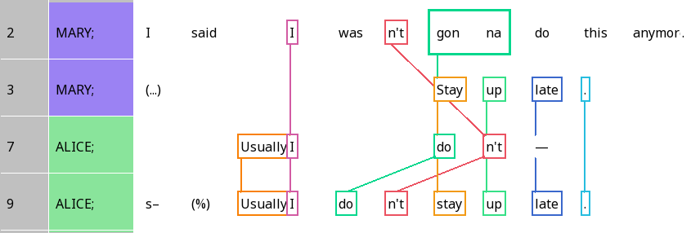
You can resonate with material from different lines!

Slide 16
Let’s have some practice!

Slide 17
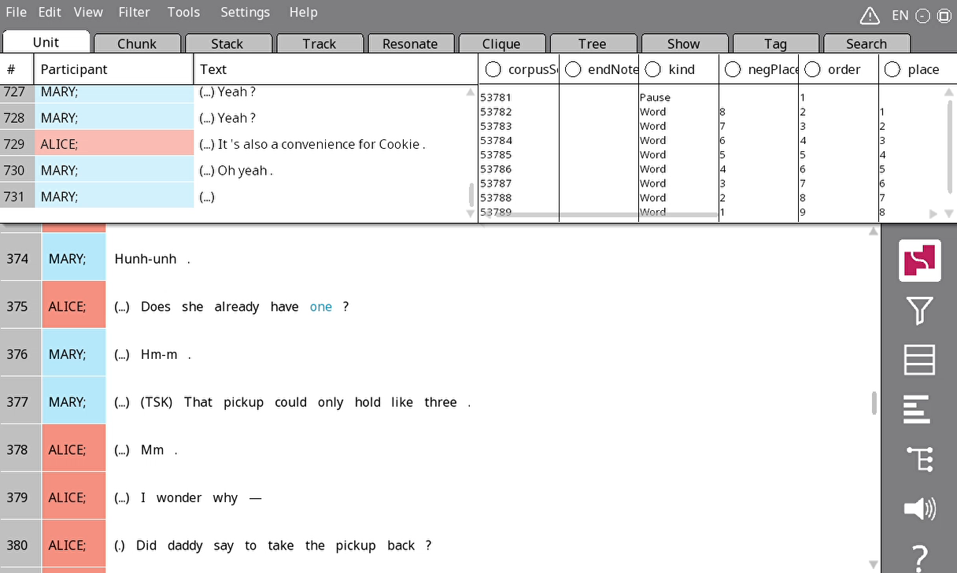
Jumping to a line in Rezonator
Press G
Enter line number
Press OK
Can you go to Line 299?

Slide 18
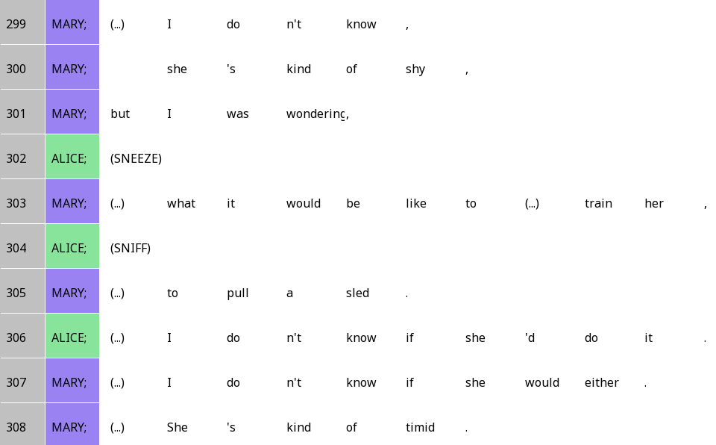
She’s kinda shy (lines 299-308)

Slide 19
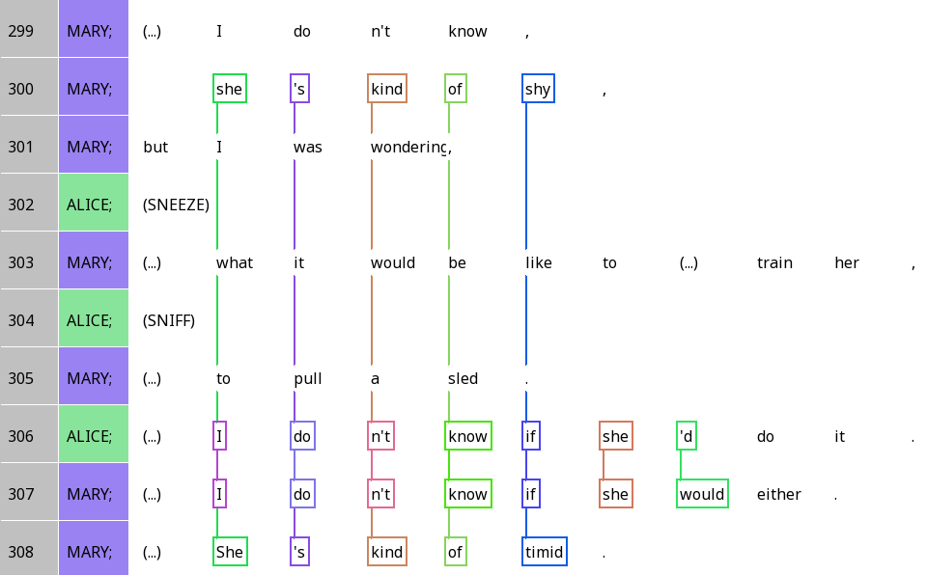
She’s kinda shy

Slide 20
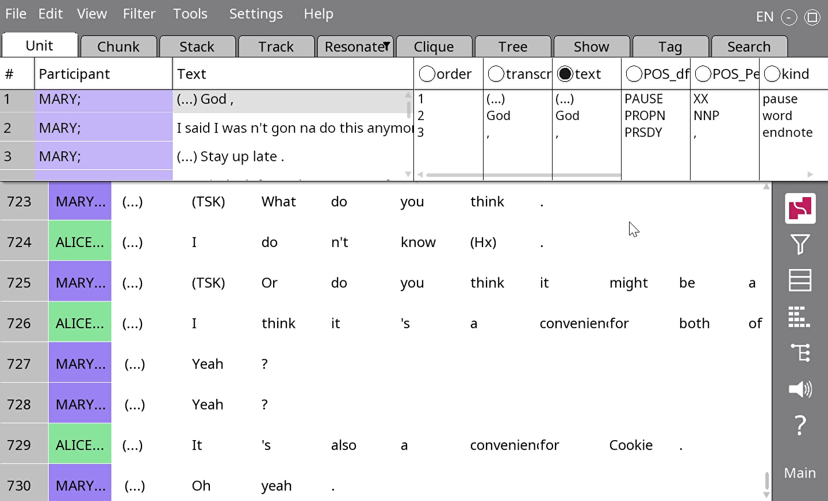
When words go offscreen
Use Settings > Narrow (or ctrl + -) to make the columns narrower
Use arrow keys to scroll horizontally

Slide 21
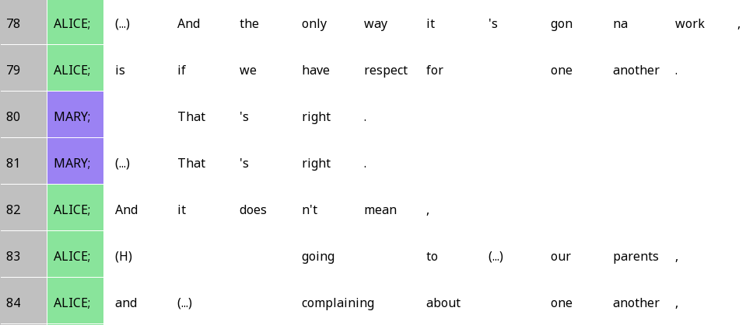
The only way it’s gonna work (lines 78-84)

Slide 22
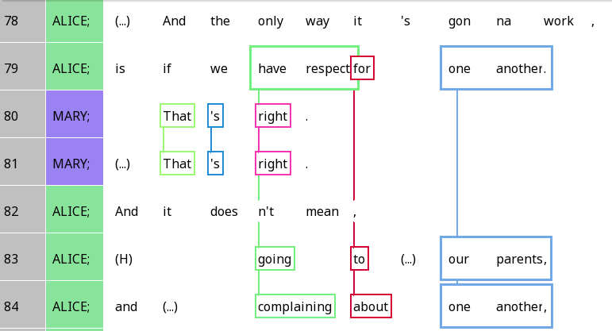
The only way it’s gonna work

Slide 23
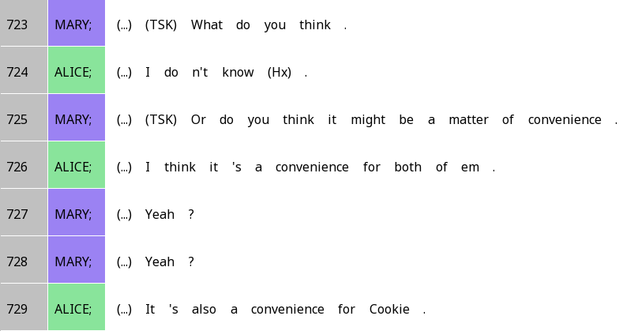
A matter of convenience

Slide 24
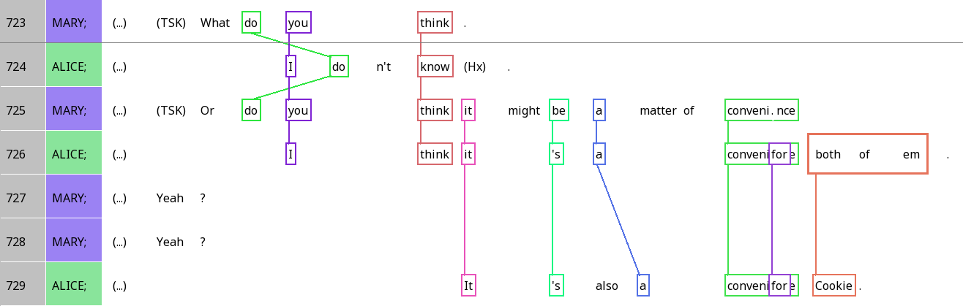
A matter of convenience

Slide 25

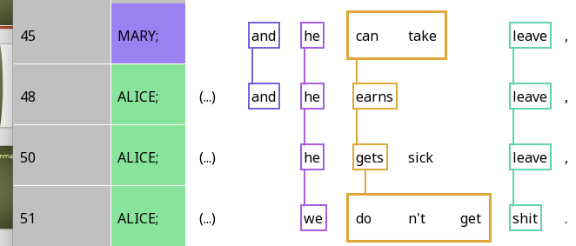
Cliques
A group of interlinked units

Slide 26
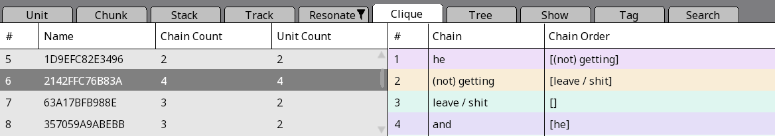
The clique pane
Number of resonances
Number of units
Specific resonance chain
Which chains can follow the present one?

Slide 27
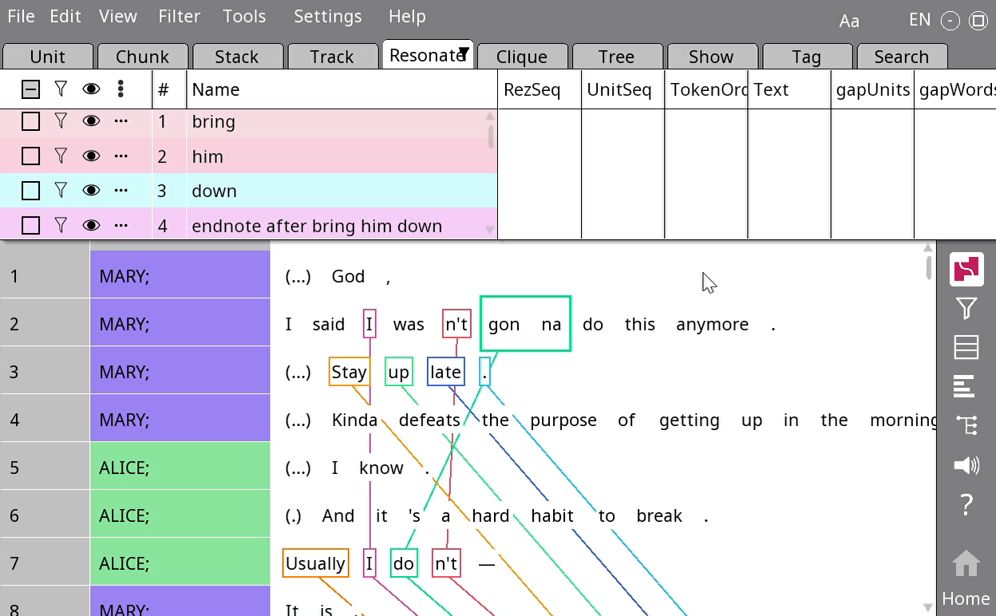
The clique stacker
Go to Tools > Stacker > Clique
Press OK

Slide 28
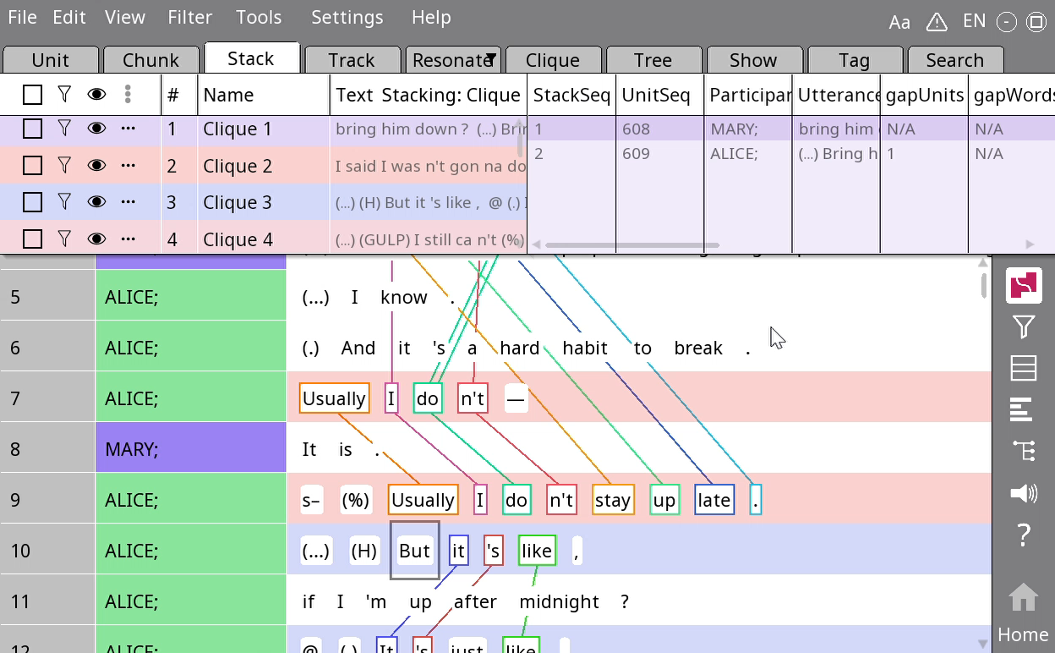
Going through the clique stacking
Right-click on a clique > Rename
Type in a new name > Press OK
You now have an easy way to navigate between cliques!

Slide 29

When silence is ellipsis
Ellipsis: When something is left out because it is implied to be the same as a previous utterance
 | Stance subject | Position |  |  | Stance object |  |  |  |  | Alignment
Alice | I | do | n’t | know | if | she | ‘d | do | it
Mary | I | do | n’t | know | if | she | would | (do) | (it) | either
Question: Do you think ellipsis is more likely with frame resonance or focal resonance?

Slide 30
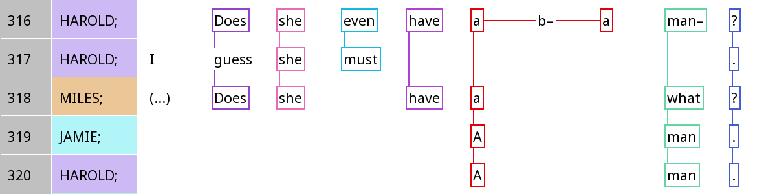
Ellipsis in repair

Slide 31
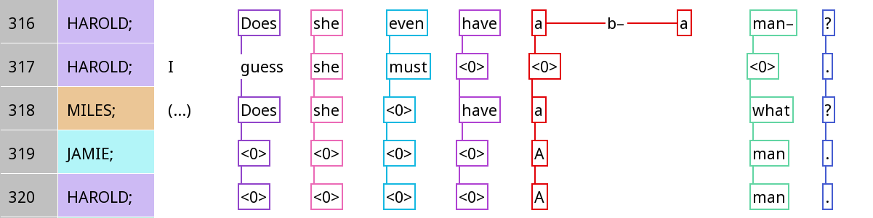
Ellipsis in repair

Slide 32
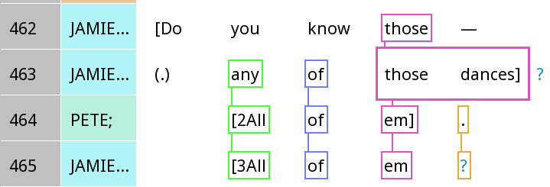
Ellipsis and Q&A

Slide 33
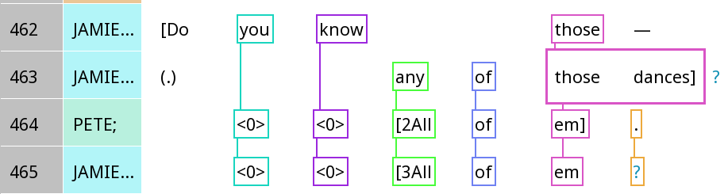
Ellipsis and Q&A

Slide 34
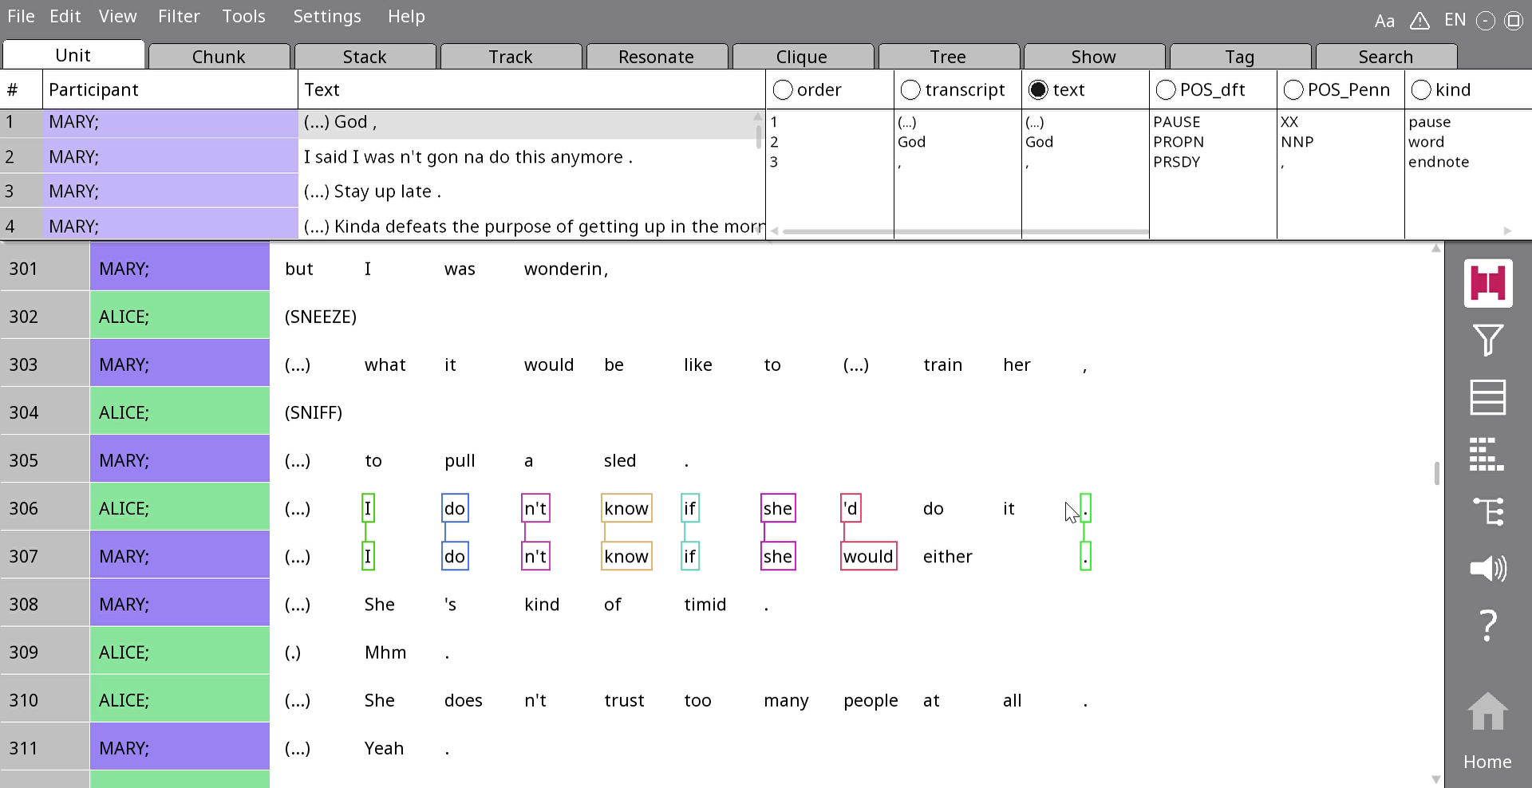
Annotating ellipsis
Hover over the token after the one you want to put a <0> in
Press z on your keyboard
Now you can draw resonances

Slide 35
Your turn (2)
Find an example of ellipsis among any of the examples of Q&A, repair, or other resonance that you’ve worked on, and annotate the ellipsis.

